Slide 1
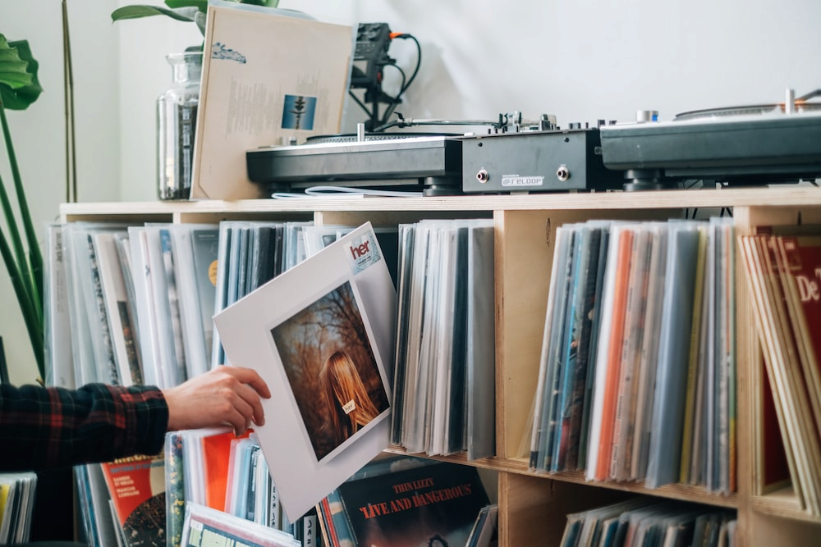

🎼 Record Shop Inventory App
Takako Onozuka

Slide 2


Meet my client
Name: Richard G
Age: 72
Location: Ayr, South Ayrshire
Occupation: Semi-retired / Runs a small record shop, Seaside Records. Sells records both in person and online.
Lives with: Partner and two dogs

Slide 3
What my client said:
I want something to organise my records.
My eyesight is not in the best condition, so I’d like something simple and easy to understand.

Slide 4
What Richard can do with Record Shop Inventory App
BASIC funtions:
View all the records in stock
View all the artists in the database
View all the genres in the database
View all the records by a genre
View all the records by an artists
Add / edit a records
Add / edit an artists
Create a new genre
View details of each record / artist, with edit option

Slide 5
What Richard can do with Record Shop Inventory App
BASIC funtions:
VIEW
All the records
All the artists
All the genre
Record details
Artist details
CREATE
Record entry
Artist entry
Genre entry
SORT
By artist
By genre

Slide 6
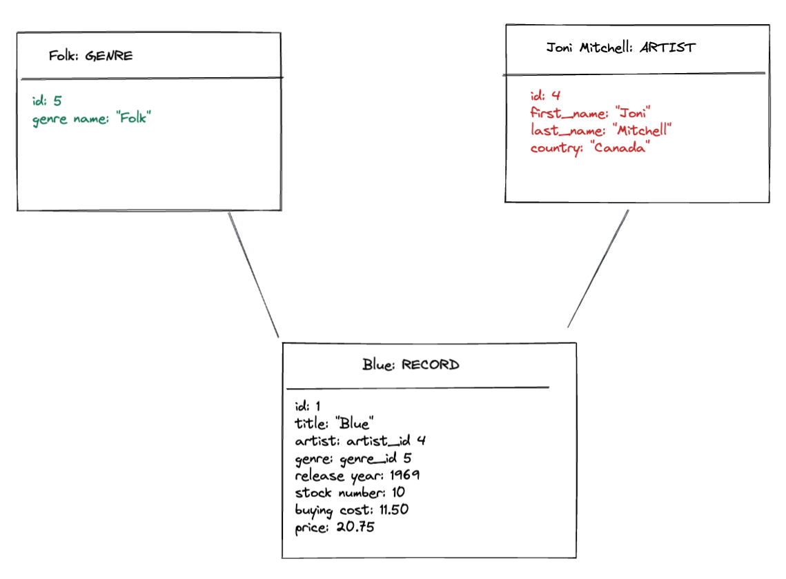
Object diagram

Slide 7
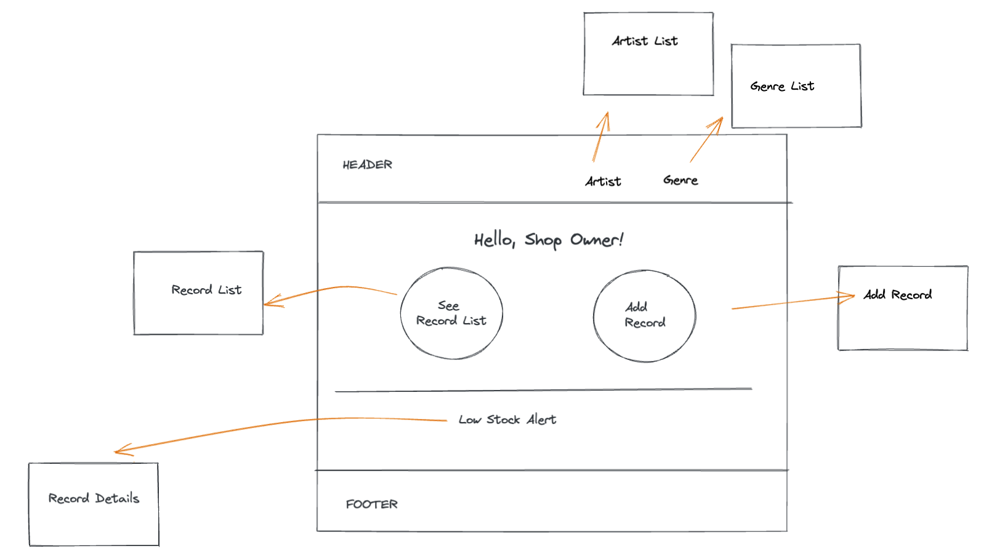
Wireframe : “Home” page

Slide 8
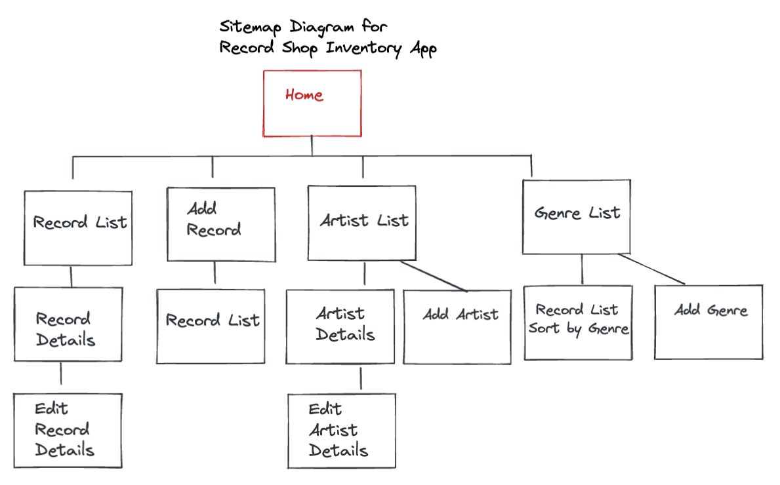

Slide 9
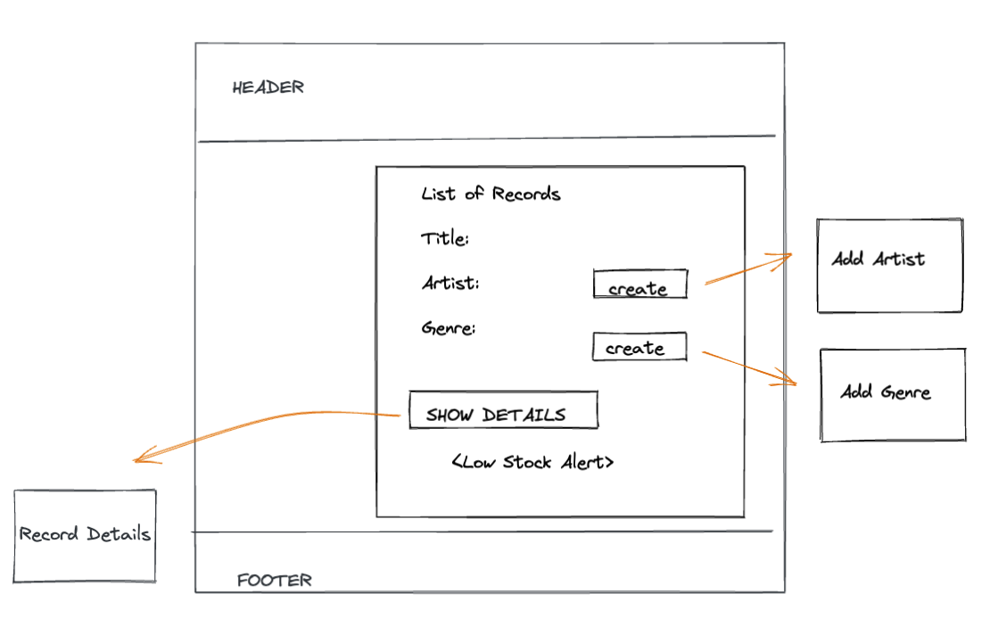
Wireframe : “List” page

Slide 10
What Richard can do with Record Shop Inventory App
PLUS funtions:
Gets “low stock” notification when the stock is less than 3
View a markup for each record
View artists in alphabetical order
Contact me if there is any issues

Slide 11

Demo time!
One of Richard’s dogs, Connie

Slide 12
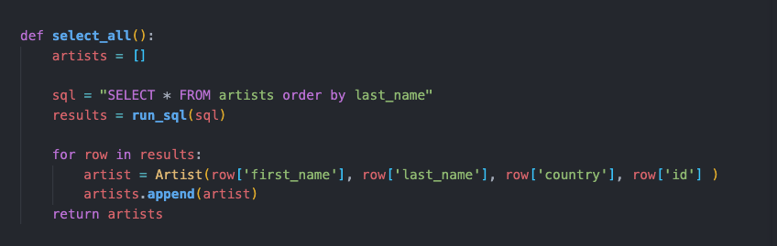
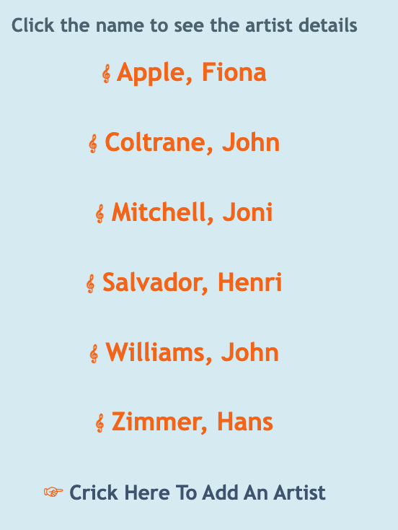
The memorable code for Record Shop Inventory App
artist_repository.py

Slide 13
What I am happy about Record Shop Inventory App
Interactive
As an extension, I decided to add the third db table. Record db table references Artist and Genre tables. And it worked!

Slide 14
What I learnt from Record Shop Inventory App
(Apart from the obvious...)
How to read error messages
30 minutes of planning could save a whole afternoon.
Exta 30 minutes of coding while tired could cost a whole next day.
You can be oblivious to something obvious to other people’s eyes. Ask help.

Slide 15

Next Step For Record Shop Inventory App
Add “View Sales” page to see monthly / weekly sales and profit.
Add “Image Upload” on ”Add Record” page, so images of each record will appear on the record list

